Slide 1

SRI INDU COLLEGE OF ENGINEERING AND TECHNOLOGY DEPARTMENT OF AIML
IV BTECH I SEM
BATCH : 9
SUBJECT: Data Mining Laboratory
TOPIC: AIR QUALITY INDEX(AQI) PREDICTOR
TEAM MEMBERS:
S.Sirisha | 23D41A66G9
T.Harini | 23D41A66H0
T.Rishwanth | 23D41A66H1
U.Navya | 23D41A66H2
U.Akash | 23D41A66H3
Batch 9

Slide 2
ABSTRACT
The Air Quality Index (AQI) Prediction System uses machine learning to classify air quality based on PM2.5 concentration, hour, and month. It predicts air quality categories using three algorithms: Decision Tree, Naive Bayes, and K-Nearest Neighbors (KNN).
Developed using Python and Streamlit, the system provides an interactive interface for viewing predictions, comparing model performance, and understanding potential health risks through visualizations and health recommendations.
Batch 9

Slide 3
EXISTING SYSTEM
Traditional systems measure pollutant concentrations and classify air quality according to established standards. However, interpreting raw measurements and understanding their health effects can be difficult for ordinary users.
Limitations:
Raw pollution data can be difficult to understand.
Interactive visualizations may be limited.
Comparing machine learning models may require additional tools.
Health recommendations may not be clearly presented.
Batch 9

Slide 4
PROPOSED SYSTEM
The proposed system uses machine learning to classify air quality based on historical environmental data. It provides an interactive Streamlit application where users can enter environmental values, view predicted categories, and understand potential health effects.
Key Features:
Data preparation and preprocessing.
Decision Tree, Naive Bayes, and KNN algorithms.
AQI prediction using PM2.5, hour, and month.
Model performance comparison and visualizations.
Health recommendations based on predicted air quality.
Batch 9

Slide 5
HARDWARE AND SOFTWARE REQUIREMENTS
Hardware Requirements
Processor: Intel Core i3 or above
RAM: 4 GB or above
Hard Disk: 10 GB free space
Operating System: 64-bit computer
Software Requirements
Programming Language: Python
Libraries: Pandas, NumPy, Scikit-learn
Web Framework: Streamlit
Visualization: Plotly
IDE: Visual Studio Code
Web Browser: Google Chrome
Batch 9

Slide 6
IMPLEMENTATION
The system follows a sequence of steps to process historical environmental data, train machine learning models, and generate air quality predictions.
Load the air quality dataset.
Prepare input features and target categories.
Split the dataset into training and testing sets.
Train Decision Tree, Naive Bayes, and KNN models.
Evaluate and compare model performance.
Display predictions, visualizations, and health recommendations.
Batch 9

Slide 7
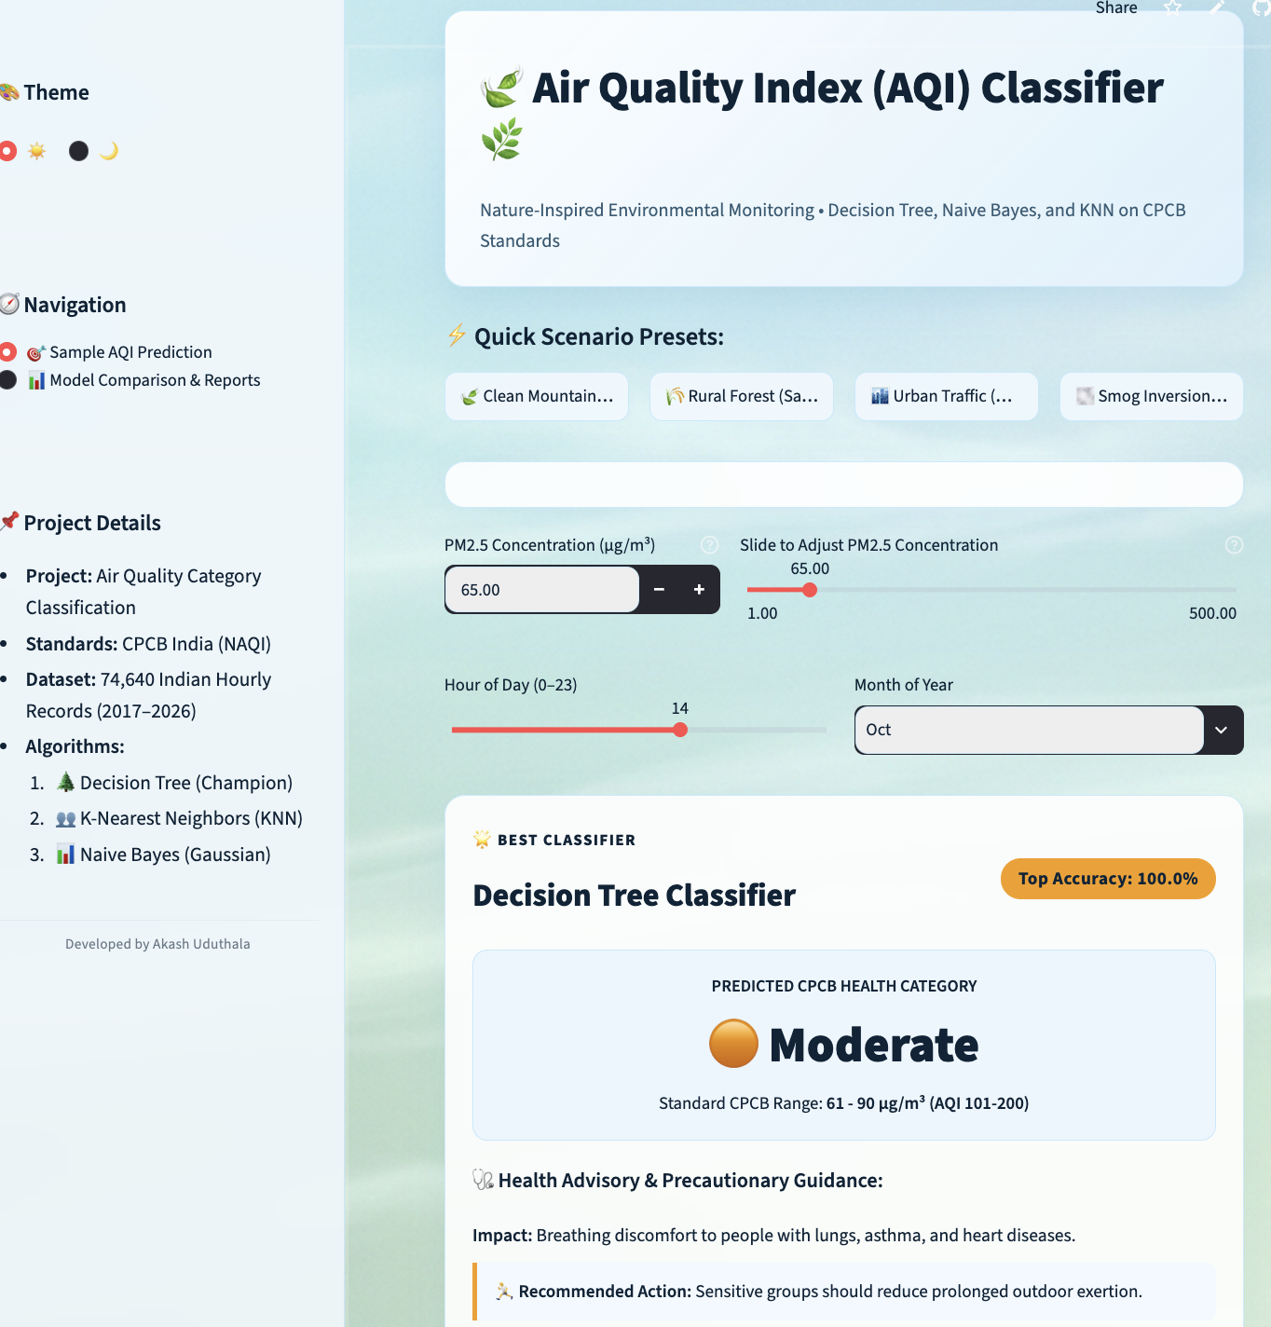
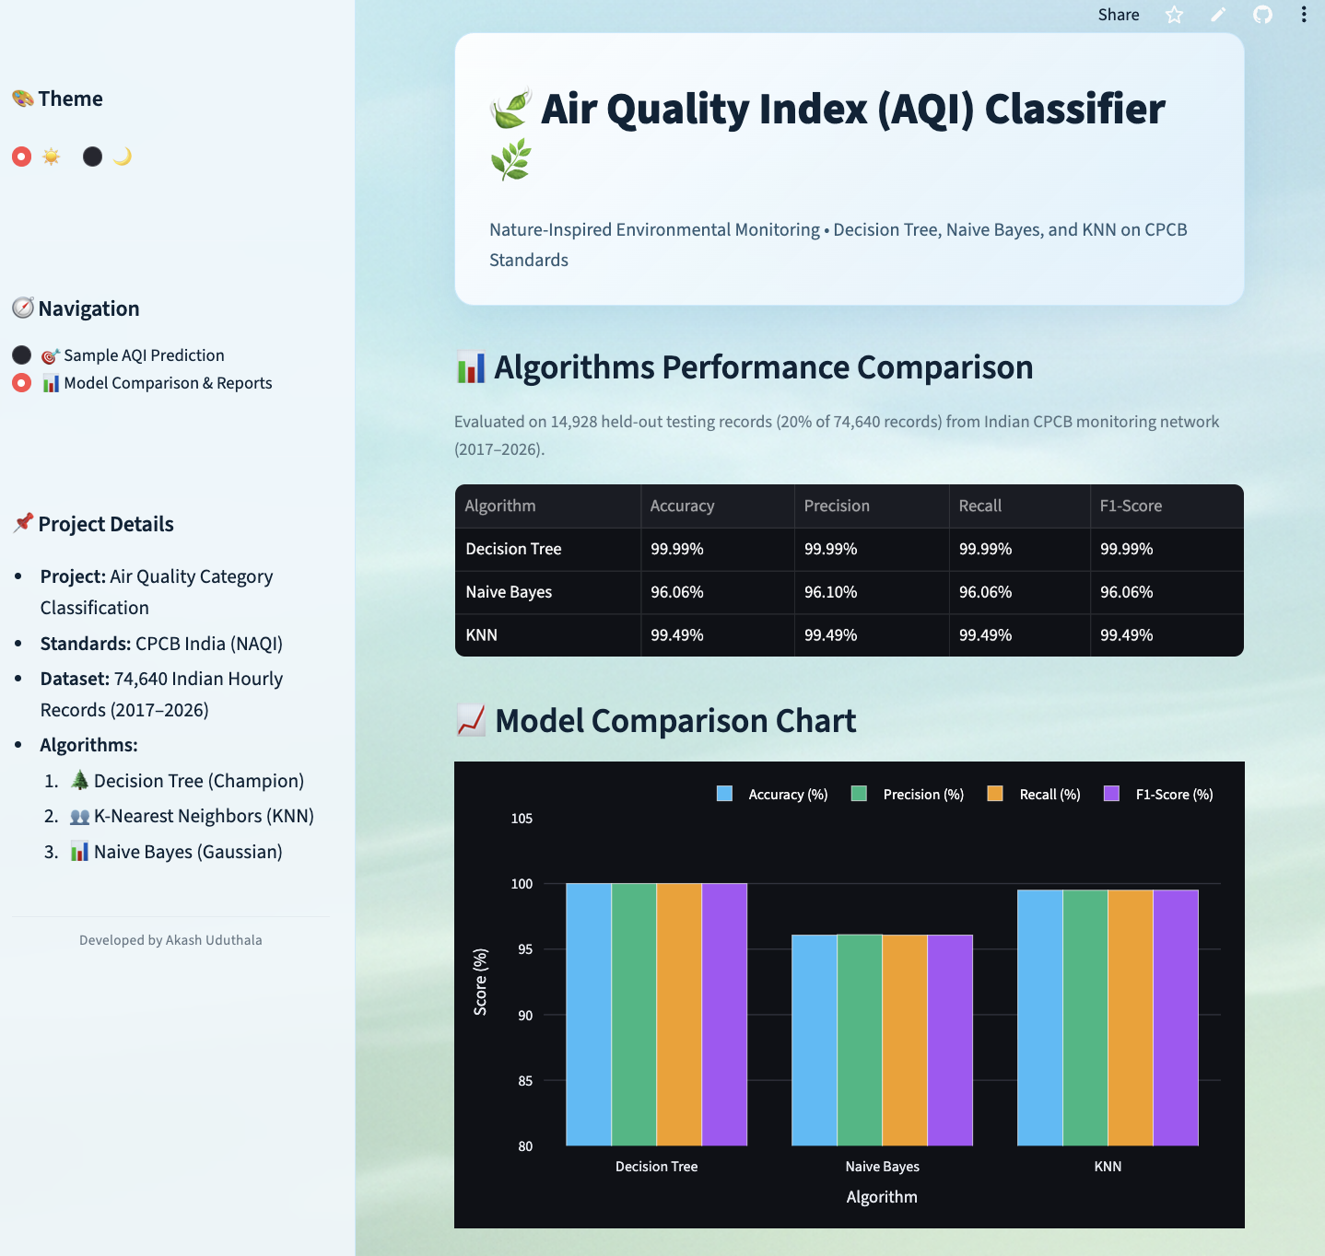
OUTPUT
Batch 9

Slide 8
CONCLUSION
The AQI Prediction System demonstrates how data mining and machine learning can be used to classify air quality from environmental data. It provides a user-friendly interface for predicting pollution categories and comparing the performance of three classification algorithms.
The system also presents visualizations and health recommendations to improve awareness of pollution levels. Future enhancements may include real-time sensor integration, additional pollutant measurements, and air quality forecasting.
Batch 9

